Slide 1


UNIVERSITY INSTITUTEOF ENGINEERING
Bachelor of Engineering (Computer Science & Engineering)
Operating System (CST-328)
Subject Coordinator: Er. Puneet kaur (E6913)
Introduction to Operating System
DISCOVER . LEARN . EMPOWER
Font size 24

Slide 2
Chapter 4 (Memory Management) Memory Management: Address binding, logical versus physical address space, dynamic loading, Swapping, contiguous memory allocation, Fragmentation, Paging, Segmentation, Segmentation with Paging, Virtual Memory Concept, Demand Paging, Page Replacement, Page Replacement Algorithms.

Slide 3
Address Binding
Address binding is the process of mapping the program's logical or virtual addresses to corresponding physical or main memory addresses
Compile time. The compiler translates symbolic addresses to absolute addresses. If you know at compile time where the process will reside in memory, then absolute code can be generated (Static).
Load time. The compiler translates symbolic addresses to relative (relocatable) addresses. The loader translates these to absolute addresses. If it is not known at compile time where the process will reside in memory, then the compiler must generate relocatable code (Static).
Relocatable means that the program image can reside anywhere in physical memory.
Execution time. If the process can be moved during its execution from one memory segment to another, then binding must be delayed until run time. The absolute addresses are generated by hardware. Most general-purpose OSs use this method (Dynamic).

Slide 4
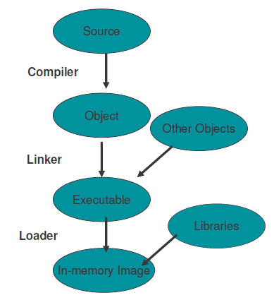

Slide 5
Memory Management
Main Memory refers to a physical memory that is the internal memory to the computer. The word main is used to distinguish it from external mass storage devices such as disk drives. Main memory is also known as RAM.

Slide 6
Memory Management
At times one program is dependent on some other program. In such a case, rather than loading all the dependent programs, CPU links the dependent programs to the main executing program when its required. This mechanism is known as Dynamic Linking.
Linking postponed until execution time.
Small piece of code, stub, used to locate the appropriate memory-resident library routine.
Stub replaces itself with the address of the routine, and executes the routine.
Operating system needed to check if routine is in processes’ memory address.
Dynamic linking is particularly useful for libraries.

Slide 7
Memory Management
All the programs are loaded in the main memory for execution. Sometimes complete program is loaded into the memory, but some times a certain part or routine of the program is loaded into the main memory only when it is called by the program, this mechanism is called Dynamic Loading, this enhance the performance.
Routine is not loaded until it is called
Better memory-space utilization; unused routine is never loaded.
Useful when large amounts of code are needed to handle infrequently occurring cases.
No special support from the OS is required - implemented through program design.

Slide 8
Process Address Space
The process address space is the set of logical addresses that a process references in its code. For example, when 32-bit addressing is in use, addresses can range from 0 to 0x7fffffff; that is, 2³¹ possible numbers, for a total theoretical size of 2 gigabytes.
The operating system takes care of mapping the logical addresses to physical addresses at the time of memory allocation to the program.

Slide 9
Process Address Space
There are three types of addresses used in a program before and after memory is allocated −
Symbolic addresses
The addresses used in a source code. The variable names, constants, and instruction labels are the basic elements of the symbolic address space.
Relative addresses
At the time of compilation, a compiler converts symbolic addresses into relative addresses.
Physical addresses
The loader generates these addresses at the time when a program is loaded into main memory.
Note: Virtual and physical addresses are the same in compile-time and load-time address-binding schemes.

Slide 10
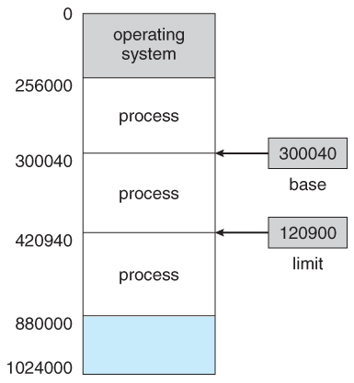
Base and Limit Registers
A pair of base and limit registers define the logical address space
CPU must check every memory access generated in user mode to be sure it is between base and limit for that user

Slide 11
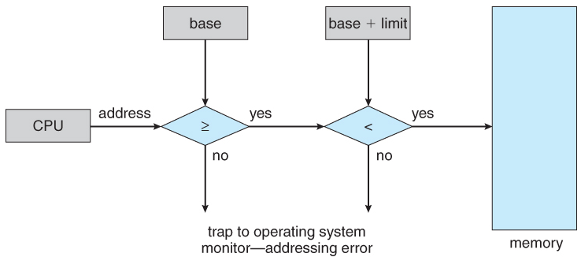
Hardware Address Protection

Slide 12
Process Address Space
Logical address – generated by the CPU; also referred to as virtual address
Physical address – address seen by the memory unit
Logical and physical addresses are the same in compile-time and load-time address-binding schemes; logical (virtual) and physical addresses differ in execution-time address-binding scheme
The set of all logical addresses generated by a program is referred to as a logical address space.
The set of all physical addresses corresponding to these logical addresses is referred to as a physical address space.

Slide 13
Physical Address Vs Physical Address Space
Physical address space in a system can be defined as the size of the main memory. It is really important to compare the process size with the physical address space. The process size must be less than the physical address space.
Physical Address Space = Size of the Main Memory If, physical address space = 64 KB = 2 ^ 6 KB = 2 ^ 6 X 2 ^ 10 Bytes = 2 ^ 16 bytes Let us consider, word size = 8 Bytes = 2 ^ 3 Bytes Hence, Physical address space (in words) = (2 ^ 16) / (2 ^ 3) = 2 ^ 13 Words Therefore, Physical Address = 13 bits In General, If, Physical Address Space = N Words then, Physical Address = log₂ N

Slide 14
Logical Address vs Logical Address Space
Logical address space can be defined as the size of the process. The size of the process should be less enough so that it can reside in the main memory.
Logical Address Space = 128 MB = (2 ^ 7 X 2 ^ 20) Bytes = 2 ^ 27 Bytes Word size = 4 Bytes = 2 ^ 2 Bytes Logical Address Space (in words) = (2 ^ 27) / (2 ^ 2) = 2 ^ 25 Words Logical Address = 25 Bits In general, If, logical address space = L words Then, Logical Address = Log₂L bits

Slide 15
Conclusion
This lecture makes the student familiar with Memory management topics like logical memory, physical memory, virtual memory, dynamic linking, dynamic loading and process address space etc.

Slide 16
Video Links
https://www.youtube.com/watch?v=DdUeTN0qfuE
https://www.youtube.com/watch?v=Rnfu5qyysro

Slide 17
References
https://www.tutorialspoint.com/operating_system/os_memory_management.htm
https://www.studytonight.com/operating-system/memory-management
https://www.guru99.com/os-memory-management.html
https://www.geeksforgeeks.org/partition-allocation-methods-in-memory-management/
https://www.javatpoint.com/os-memory-management-introduction
http://www2.latech.edu/~box/os/ch08.pdf
https://www.cs.uic.edu/~jbell/CourseNotes/OperatingSystems/8_MainMemory.html#:~:text=8.3%20Contiguous%20Memory%20Allocation,allocated%20to%20processes%20as%20needed.
http://www.csdl.tamu.edu/~furuta/courses/99a_410/slides/chap08

